Slide 1

Adarsh Institute of Technology & Research Centre,Vita
Department of Computer Science and Engineering
Project Presentation
On
“Farm-Tech Website”
Presented by:
Miss. Deshmukh Radhika Ravindra
Miss. Jadhav Kiran Popat
Miss. Patil Samruddhi Pramod
Miss. Rajmane Shruti Shankar
Under the guidance of:
Prof S.L.Jadhav

Slide 2
CONTENTS
Introduction
Existing system
H/W and S/W Requirements
Proposed system
Advantages
Disadvantages
Block diagram
Application area
Modules
Conclusion
Reference

Slide 3
INTRODUCTION
In this website, we are giving detailed information about the Agriculture and its operations. The website is designed in an interactive manner and is able to give the farmers the knowledge for better quality crops and best sale price.
Our website also helps to connect farmer with the new technology and make farming task simpler.
A different section has been provided for contacting the customers for different types of grains, vegetables, and fruits.
Farmers can connect to the world via technology and can export agro products.
Water scarcity farming can be achieved because of our FARM-TECH project.

Slide 4
EXISTING SYSTEM
Earlier the records were kept done manually which was highly time consuming and expensive.
Technical difficiency.
Excessive use of pesticides and insectisides can cause soil erosion.

Slide 5
H/W AND S/W REQUIREMENTS
HARDWARE REQUIREMENT:
RAM - 256 MB (Min)
Hard Disk - 40 GB (Min)
Keyboard - Standard Windows Keyboard
SOETWARE REQUIREMENT:
Operating System : Windows95/98/2000/XP
Front End : HTML,CSS
Editor : Visual Studio

Slide 6
PROPOSED SYSTEM
This system helps in minimum manual work done by the farmers to get help for farming in a single click.
It helps in keeping the farmers updated about the technology of the farming.
Now a days, it has become easy to get information through websites. There is no need to read newspaper magazines and interviews etc are required to get information about farming because each and every information is easily available on the website.

Slide 7
ADVANTAGES
It enables 24/7 online technical help.
It helps in relevant information exchange.
Increase productivity.
Different methods of rainwater harvesting.
Level up the knowledge for farming using technology.
This can be the subtle way than traditional ways.

Slide 8
DISADVANTAGES
Environmental barriers.
Small types of cause serious misunderstanding.
Low confidence about technology.

Slide 9
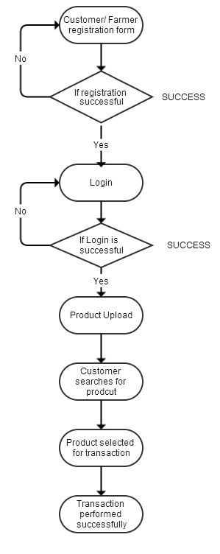
BLOCK DIAGRAM

Slide 10
APPLICATION AREA
Farmers in various areas of country.
Agricultural students.
In climate, weather department.
Farming inventory management software.

Slide 11
CONCLUSION
This website keeps detailed information about the different methods of farming and centers of a farming. This website intends to provide information about the facilities and services of the farming. This website is the official website of farmers blog. It gives all the information about the latest updates, news about the working of the farming .Through this website we can also get information about information of farmers as well as farming technology.

Slide 12
REFERENCES
www.google.com
https://kisansuvidha.gov.in

Slide 13
Thank You!!!

